Slide 2
Determination of the Route of Bacterial Transfer from Adult to Larvae in Odontotaenius disjunctus
Michael Kiflezghi

Slide 3
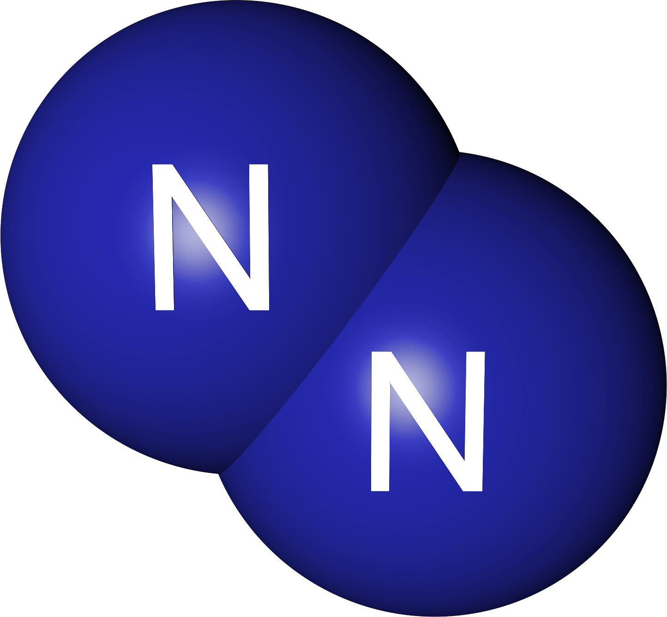
Introduction
One of the most abundant elements on the planet.
Makes up the majority of Earth’s atmosphere
Diatomic form is unusable.
Image credit: Wikipedia¹
Notes:
Nitrogen is most abundant element
It occurs in the 21 amino acids coded for by codons
By virtue of its occurrence in amino acids, it occurs in all proteins
It occurs in all organisms
It makes up the majority of earth’s atmosphere
Diatomic form is unavailable for organisms to use but is the form that exists in the atmosphere

Slide 4
Haber-Process
Used to fix diatomic nitrogen to ammonia
Requires high pressures
Very energy intensive
N₂(g) + 3H₂(g) → 2NH₃(g)
Notes:
Rxn is exothermic
Methane from natural gas is used as the source of H

Slide 5
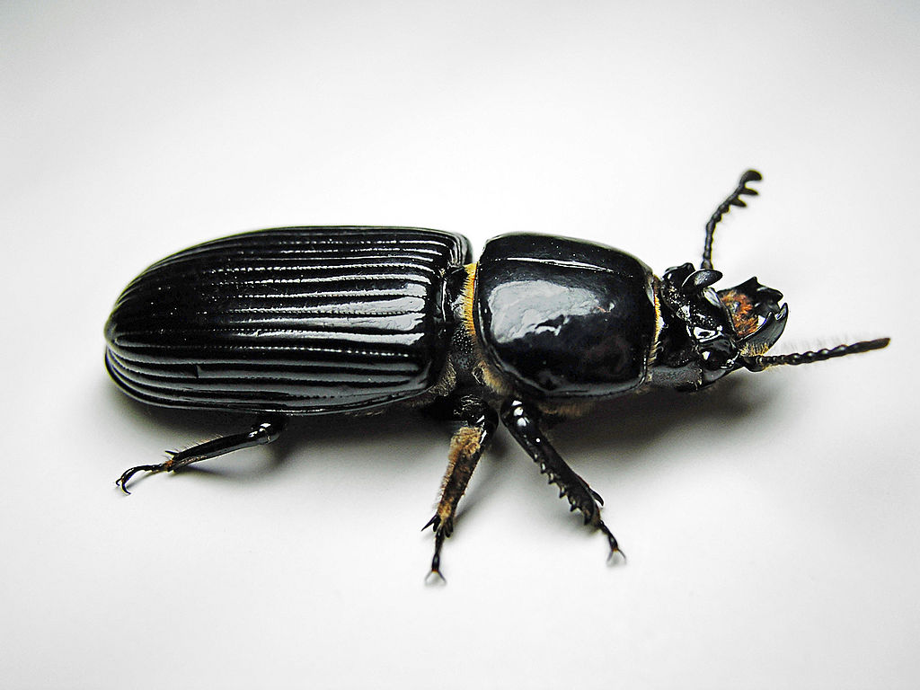
Biological Analogs
Diazotrophs can fix atmospheric nitrogen
Some form symbiotic relationships with other organisms
Odontotaenius disjunctus is one such organism
Image Credit: Wikipedia³
Notes:
Diazotrophs are bacteria and archaea that can fix atmospheric nitrogen into a more useable form at ambient temperature and pressure
It has been recently shown that there are bacteria in the gut of O. disjunctus that are fixing nitrogen (identified by confirming the incorporation of heavy nitrogen into RNA and verifying the expression of a gene coding for a subunit of nitrogenase)

Slide 6
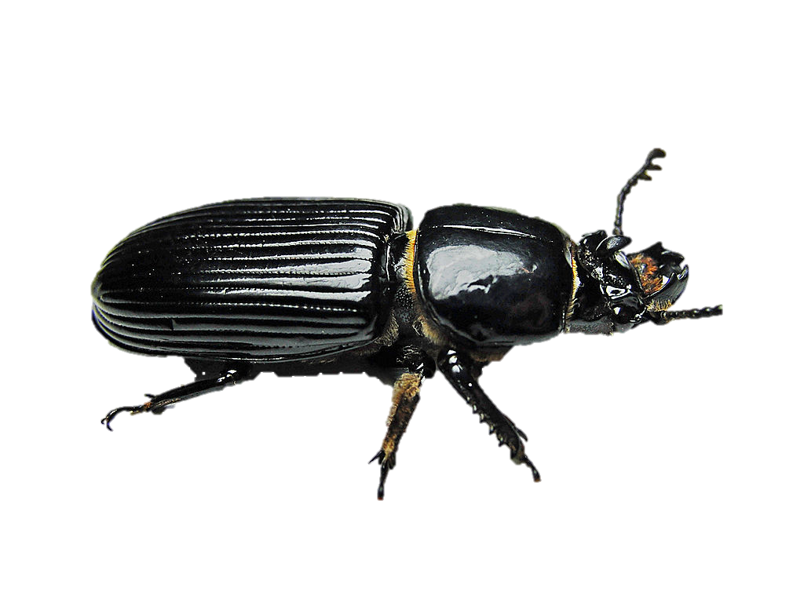
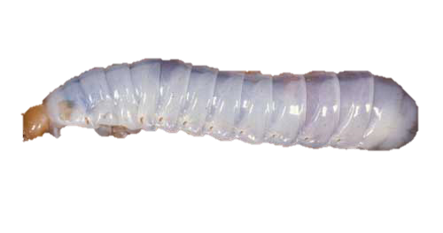
The Question
How do these beetles acquire the microbes necessary for nitrogen fixation?
More specifically: is it the case that adult O. disjunctus transfer the nitrogen fixing microbes to larvae via excrement?
?

Slide 7
Methods
Generate nitrogen fixing bacteria that express green fluorescent protein (GFP) gene
Experimental Group 1: GFP bacteria infected excrement
Expose adult O. disjunctus to GFP bacteria
Expose larvae to infected excrement
Experimental Group 2: GFP bacteria in environment
Introduce GFP bacteria into larvae environment (soil and log)
Expose larvae to excrement of non-infected adults
Determine presence of GFP bacteria in larvae gut

Slide 8
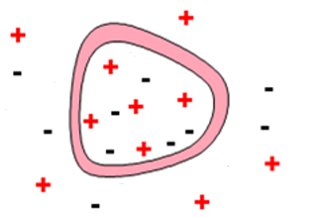
Methods: Generation of fluorescent bacteria
Transformation via Electroporation
Culture transformed bacteria

Slide 9
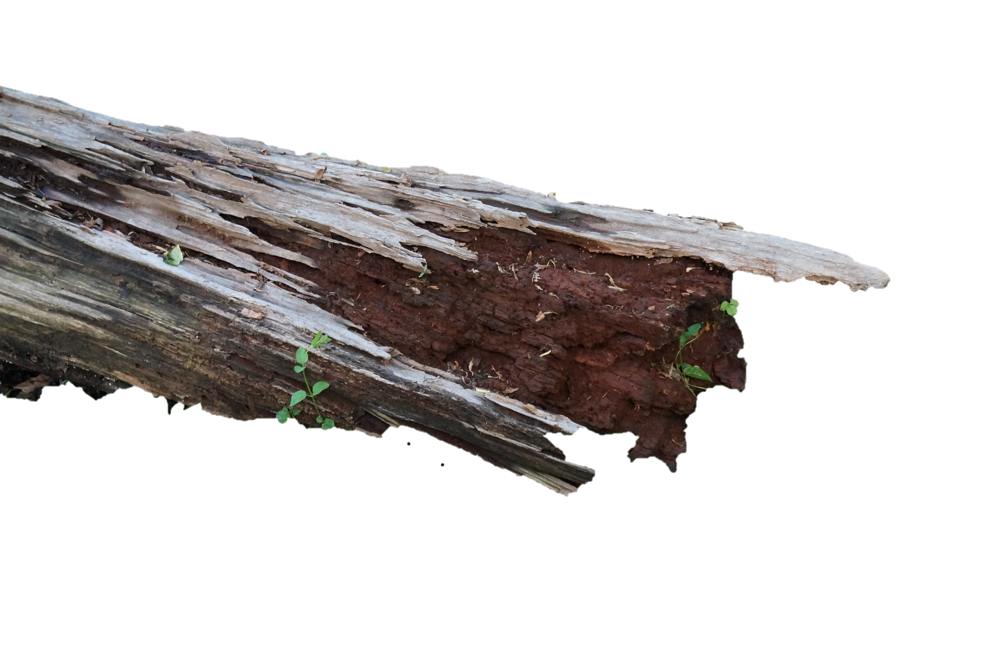
Methods: Exposure
Group 1: expose adults to GFP bacteria
Group 2: GFP bacteria in larvae environment

Slide 10
Methods: Fluorescence
Tissue will be collected and prepared
Spectrofluorometry will be used to confirm presence of GFP
Notes:
At all steps that require confirmation of the presence of the GFP bacteria, samples will be sacrificed for fluorescence.

Slide 11
Results
How are nitrogen fixing microbes acquired by larval O. disjunctus?

Slide 12
Results
Group 1:

Slide 13
References
¹ Wikipedia rendering of a nitrogen molecule: http://upload.wikimedia.org/wikipedia/en/4/43/NitrogenRencer.png
² Human population growth graph: http://www.bbc.co.uk/schools/gcsebitesize/science/edexcel/problems_in_environment/pollutionrev1.shtml
³ O. disjunctus photograph: http://en.wikipedia.org/wiki/Odontotaenius_disjunctus
⁴

